Slide 1

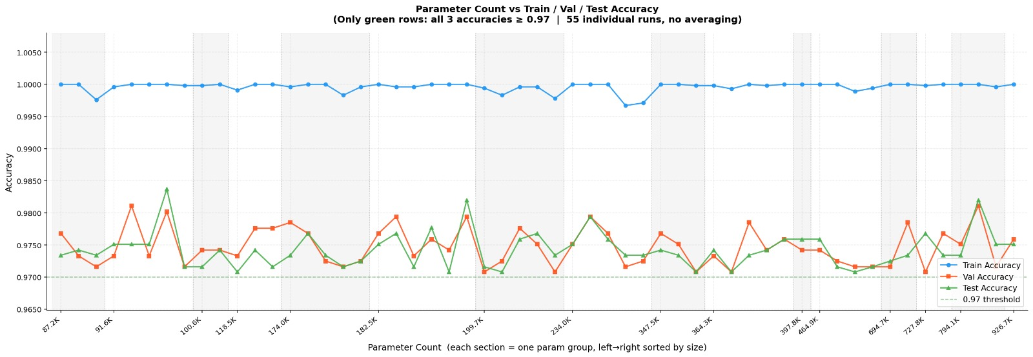
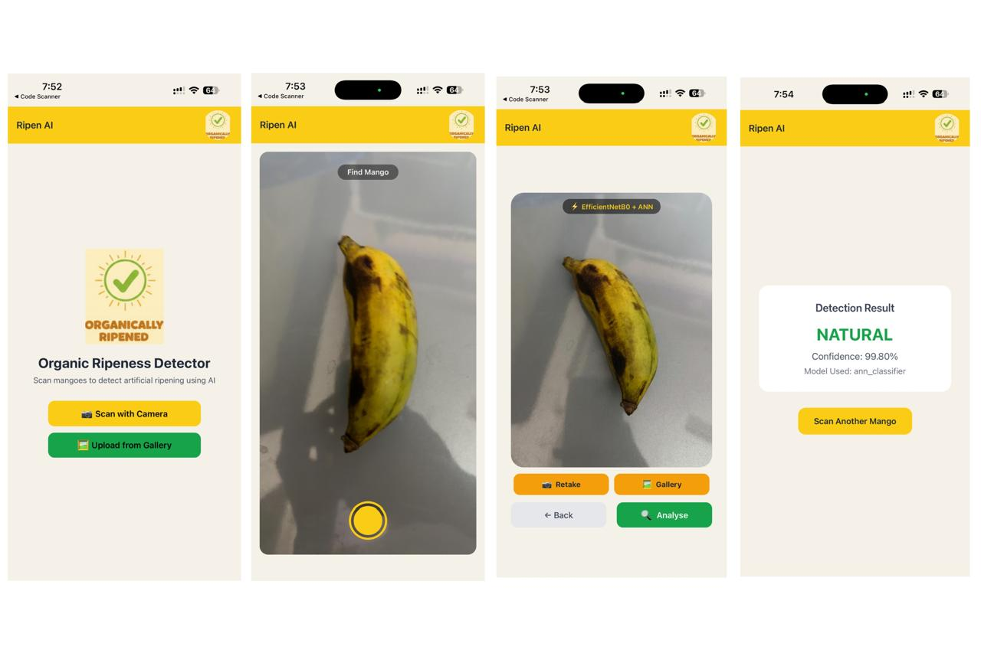
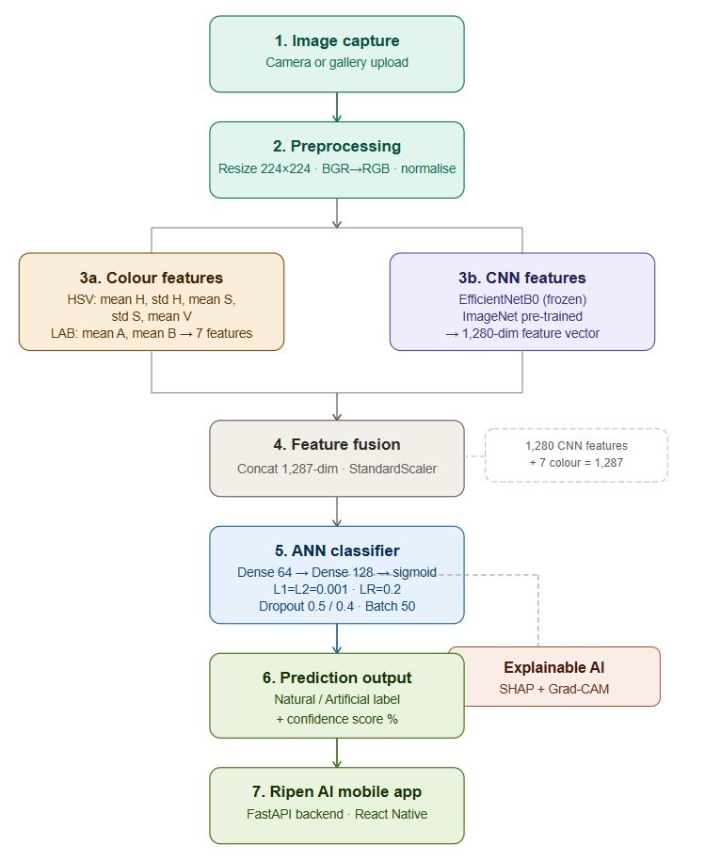
Your Project Title -Mobile App for Detecting Artificially Ripened Bananas Using Computer Vision and Colorimetric Analysis
Guide: Dr. S Rama Krishna Group By: Sri Keerthi, Lercha Vikas, Guneet Singh, Harsha Vardan
Department of Computer Science & Engineering
ABSTRACT
RESULTS
Artificial ripening of bananas using chemical agents is a major food safety concern, as it cannot be easily detected through visual inspection. This project proposes an AI-based image classification system to distinguish between naturally and artificially ripened bananas. A hybrid approach combining deep learning for feature extraction and machine learning for classification is employed to capture subtle differences in fruit characteristics. The model achieves high accuracy and reliability, while explainable AI techniques enhance the interpretability of its decisions. This system provides a fast, practical, and user-friendly solution for real-world fruit quality assessment.
INTRODUCTION
A thorough hyperparameter optimization process involving more than 500 runs was conducted to assess the performance of different ANN architectures and training techniques such as the number of hidden nodes, activation functions, regularization methods, dropout rates, learning rate, and batch size. The optimal run selected was run 376.
EfficientNetB0 + ANN achieved the best performance with 97.08% accuracy and an F1-score of 0.97, ensuring reliable classification. EfficientNetB0 enables efficient feature extraction with a smaller model size, while ANN effectively captures complex patterns, outperforming SVM and Logistic Regression. This combination provides the best balance between accuracy, efficiency, and computational cost compared to other models. Hyperparameter tuning through 505 experiments identified the optimal configuration, with 55 high-performing models. The final model demonstrates high accuracy, robustness, and suitability for real-world deployment.
Rapid advancements in computer vision and machine learning have enabled automated solutions in agriculture and food quality assessment. Detecting fruit ripeness is crucial as it directly impacts quality, safety, and market value, especially due to concerns about harmful artificial ripening methods. Traditional approaches based on human observation are subjective, inconsistent, and inefficient for large-scale analysis. This project proposes an AI-based image classification system to identify banana ripeness using deep learning techniques. The system offers a scalable, accurate, and reliable solution for improving food safety and decision-making.
PROPOSED ARCHITECTURE
AI-based system to classify bananas as natural or artificial ripening.
Images are preprocessed (resize, normalization) for consistency.
Deep features are extracted using EfficientNetB0.
Color features from HSV & LAB improve detection accuracy.
A hybrid feature set is used for classification.
An Artificial Neural Network (ANN) predicts ripeness.
The model outputs class label with probability score.
Dataset includes both real-world and online images.
System ensures accurate and reliable quality detection.
Home screen allows users to scan or upload images, followed by a camera view for capturing fruit. A preview screen provides options to retake or analyze, and the final result screen displays ripeness classification with a confidence score.
CONCLUSION & FUTURE SCOPE
The proposed AI-based system effectively detects artificially ripened bananas using a hybrid approach of CNN and ANN, achieving high accuracy and reliability. Integration with a mobile application enables real-time, user-friendly fruit quality assessment. The system can be extended to multi-class ripeness detection and multi-fruit classification. Future improvements include cloud deployment, mobile on-device inference, and further model fine-tuning for enhanced performance.
REFERENCES
Literature Review:
https://www.ijeat.org/wp-content/uploads/papers/v9i3/C6270029320.pdf
Model architecture:
• https://medium.com/image-processing-with-python/efficientnetb0-architecture-stem-layer-496c7911a62d
Data set:
https://doaj.org/article/485dce5ae1ff44bc87f0f1946c16c2ef
Classfication:
https://www.geeksforgeeks.org/machine-learning/binary-classification-using-lightgbm/
ALGORITHMS
CNN Backbones:
EfficientNetB0→4.0M params,1280 features ,MobileNetV2 →2.2M, 1280features, ResNet50 →23.6M,, 2048 features, VGG16 → 14.7M | 512 features
Classifiers:
ANN → Best generalization (91.6K params), SVM → Strong for high-dimensional data, Logistic Regression → Fast linear baseline

